Slide 1
The Client-Server Paradigm

Slide 2
The Client-Server paradigm
The Client-Server paradigm is the most prevalent model for distributed computing protocols.
It is the basis of all distributed computing paradigms at a higher level of abstraction.
It is service-oriented and employs a request-response protocol.

Slide 3
The Client-Server Paradigm
A server process, running on a server host, provides access to a service.
A client process, running on a client host, accesses the service via the server process.
The interaction of the process proceeds according to a protocol.

Slide 4
Client-server applications and services
An application based on the client-server paradigm is a client-server application.
On the Internet, many services are Client-server applications. These services are often known by the protocol that the application implements.
Well known Internet services include HTTP, FTP, DNS, finger, gopher, etc.
User applications may also be built using the client-server paradigm.
Client-server system architecture - terms clients and servers refer to computers,
Client-server distributed computing paradigm - terms refer to processes.

Slide 5
Connectionless server vs. connection-oriented server
Both Connection-oriented service and Connection-less service are used for the connection establishment between two or more two devices. These types of services are offered by the network layer.

Slide 6
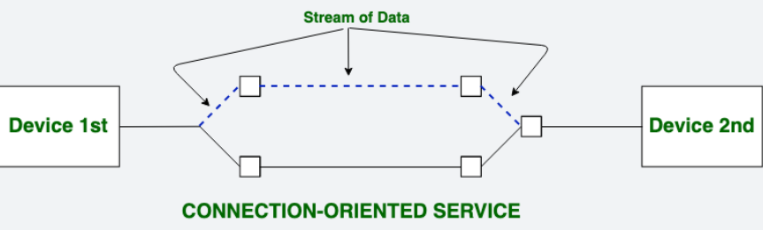
Connection-oriented Server
Connection-oriented service is related to the telephone system.
It includes connection establishment and connection termination.
In a connection-oriented service, the Handshake method is used to establish the connection between sender and receiver.
Notes:
Suppose, a sender wants to send data to the receiver. Then, first, the sender sends a request packet to a receiver in the form of an SYN packet. After that, the receiver responds to the sender's request with an (SYN-ACK) signal/packets. That represents the confirmation is received by the receiver to start the communication between the sender and the receiver. Now a sender can send the message or data to the receiver.
Similarly, a receiver can respond or send the data to the sender in the form of packets. After successfully exchanging or transmitting data, a sender can terminate the connection by sending a signal to the receiver. In this way, we can say that it is a reliable network service.

Slide 7
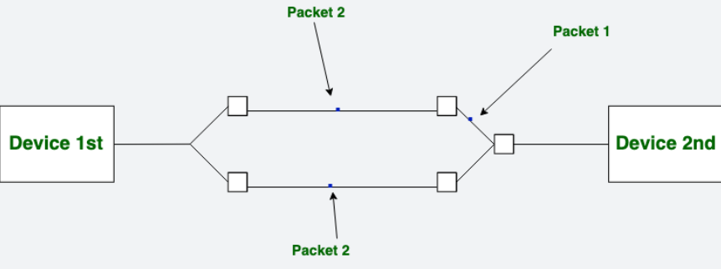
Connection-less Server
Connection-less service is related to the postal system.
It does not include any connection establishment and connection termination.
Connection-less Service does not give a guarantee of reliability. In this, Packets do not follow the same path to reach their destination.
Notes:
Suppose, a sender wants to send data to the receiver. Then, first, the sender sends a request packet to a receiver in the form of an SYN packet. After that, the receiver responds to the sender's request with an (SYN-ACK) signal/packets. That represents the confirmation is received by the receiver to start the communication between the sender and the receiver. Now a sender can send the message or data to the receiver.
Similarly, a receiver can respond or send the data to the sender in the form of packets. After successfully exchanging or transmitting data, a sender can terminate the connection by sending a signal to the receiver. In this way, we can say that it is a reliable network service.

Slide 8
Connectionless server vs. connection-oriented server
A connectionless server
Uses a connectionless IPC API (e.g., connectionless datagram socket)
Sessions with concurrent clients can be interleaved.
A connection-oriented server
Uses a connection-oriented IPC API (e.g. stream-mode socket )
Sessions with concurrent clients can only be sequential unless the server is threaded
Example: Connectionless EchoServer 1
An echo server is a server that echoes back whatever it receives from a client.
For example, if a client sends the server the string Hello there! the server will respond with the exact data it received from the client - Hello there!

Slide 9
EchoServer1.java
Forever Looping
Server reads line from socket and then writes the line back to the socket addressing reply to sender
Since there is no connection, server can interact with many clients interleaving messages

Slide 10
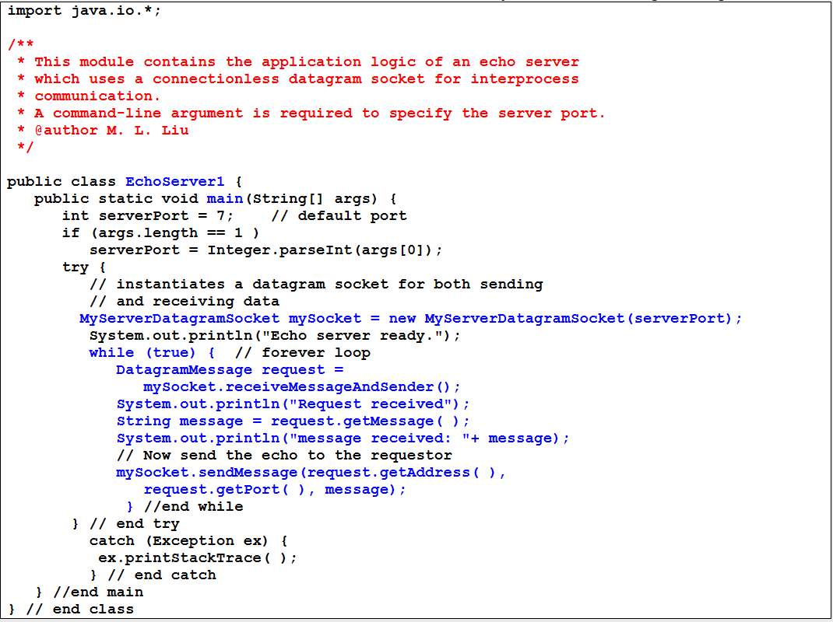

Slide 11
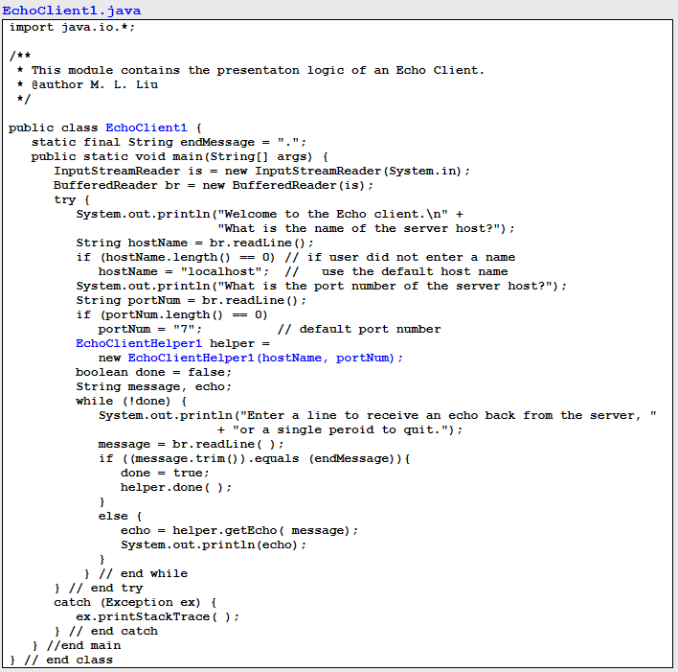

Slide 12
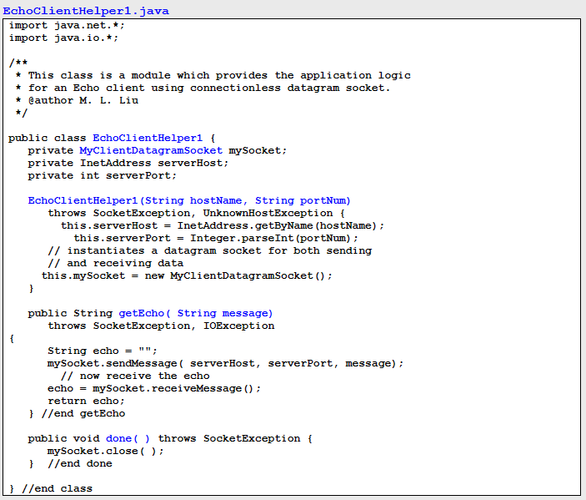

Slide 13
Need for Concurrency in Servers
A simple server
Server creates a socket, binds address, and makes it passive
Server accepts a connection, services the request, the connection is closed, and this is repeated indefinitely
Simple server is inadequate for most applications since the request may take arbitrarily long to service
Other clients are blocked from service

Slide 14
Concurrent versus Iterative Servers
An iterative server services one request at a time
A concurrent server services multiple requests at the same time
The actual implementation may or may not be concurrent
More complex than iterative servers

Slide 15
Three Dimensions of Server Design
Iterative versus concurrent
Truly a server design issue as it is independent of the application protocol
Connection-oriented versus connectionless
Usually constrained by the application protocol
Stateless versus stateful
Usually constrained by the application protocol

Slide 16
Four Classes of Servers
Concurrent, connection-oriented is the most common server design

Slide 17
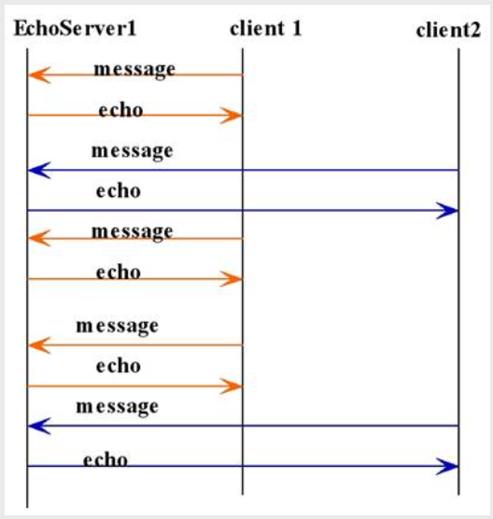
Concurrent client sessions with EchoServer1

Slide 18
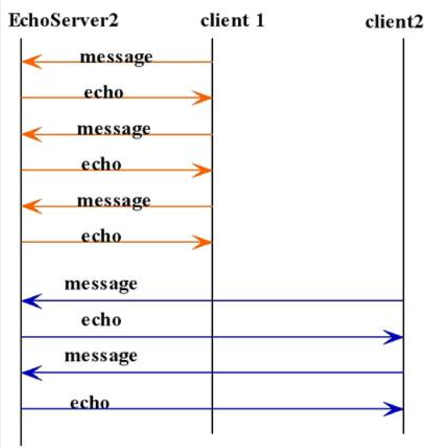
Two consecutive client sessions with echo server2
Example: Connection-oriented EchoServer 2 – Iterative Server
Uses stream-mode socket API
No Overlapping of Sessions

Slide 19
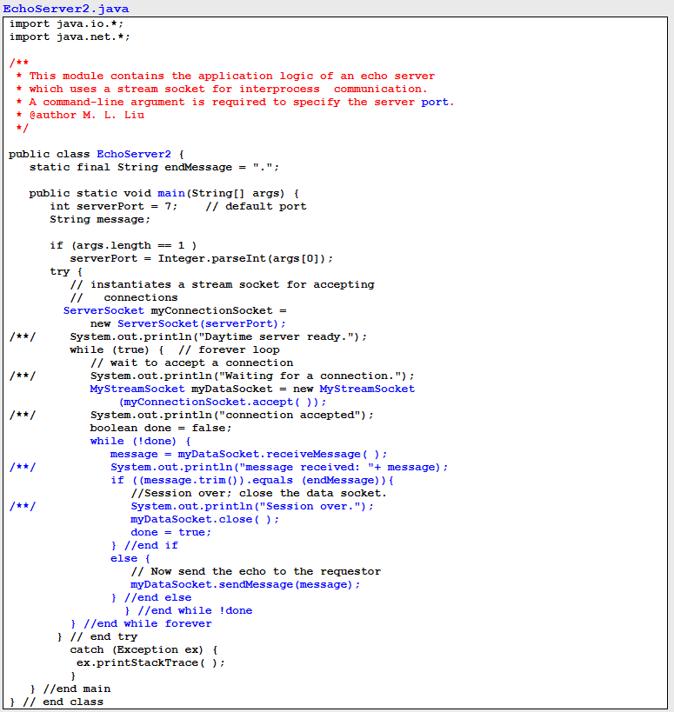

Slide 20
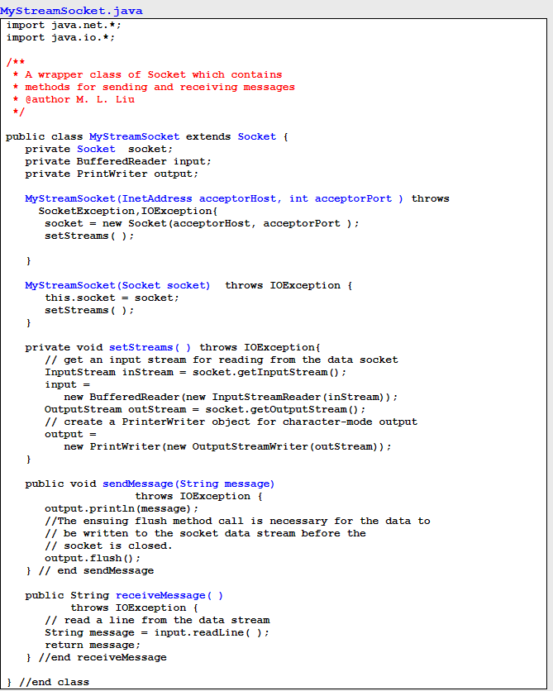

Slide 21
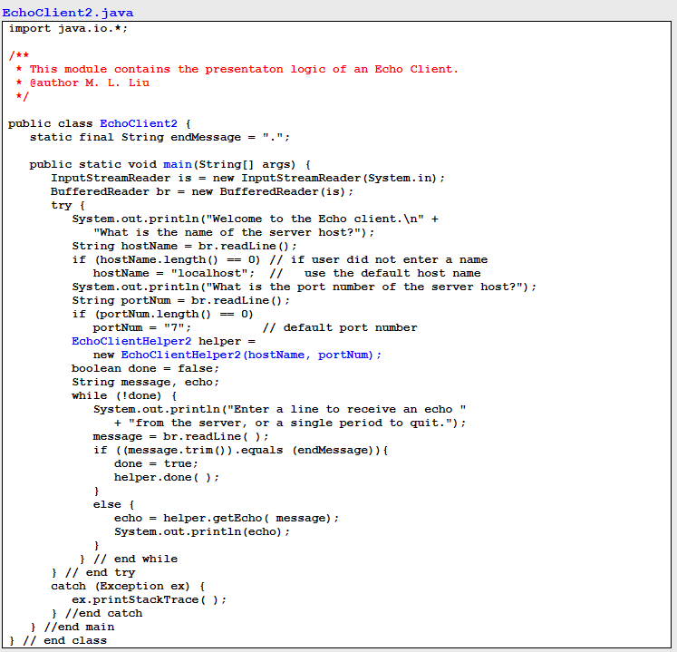

Slide 22
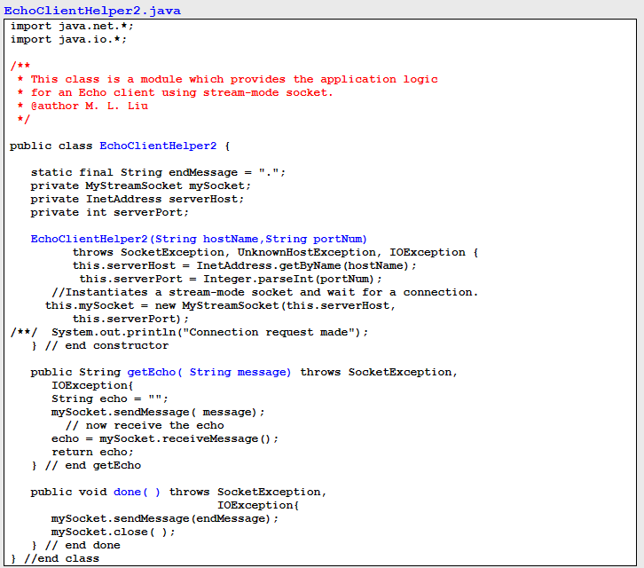

Slide 23
Iterative servers vs. Concurrent servers
A connection-oriented server can be threaded so that it can service multiple clients concurrently. Such a server is said to be a concurrent server.
An unthreaded connection-oriented server is said to be an iterative server.

Slide 24
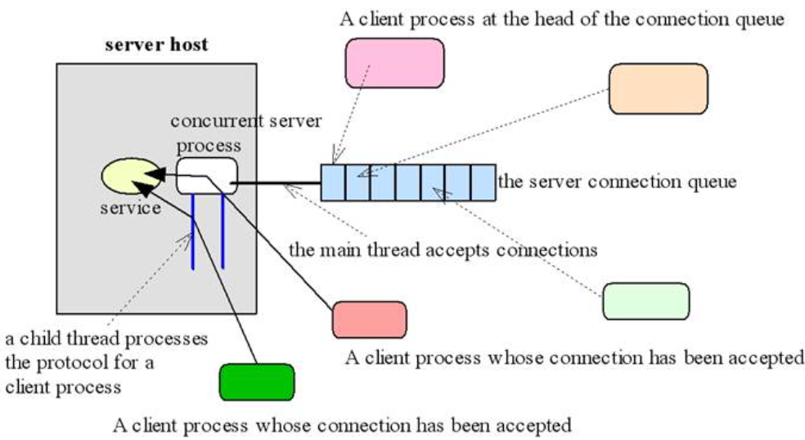
A Concurrent, Connection-oriented Server

Slide 25
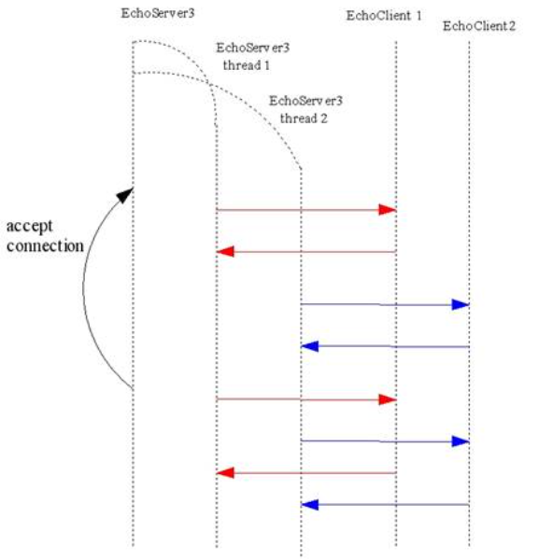
Sequence diagram – EchoServer3
Example: Concurrent Server - EchoServer 3
Client-side unchanged – can use EchoClient2

Slide 26
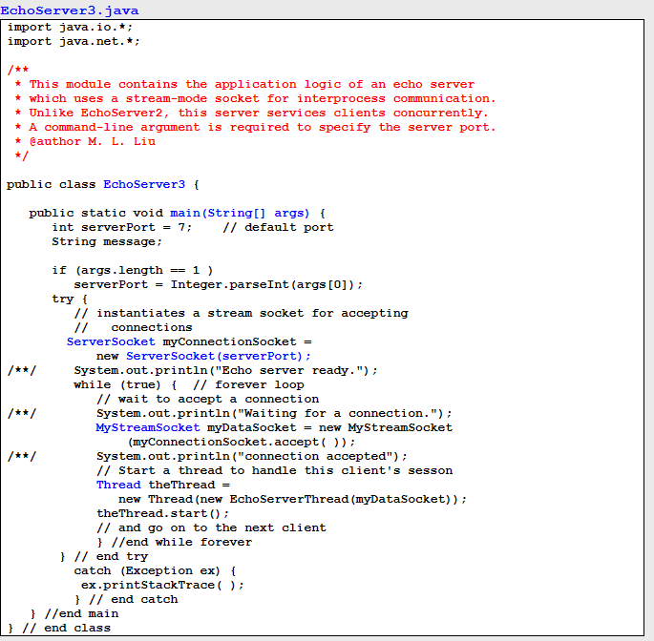

Slide 27
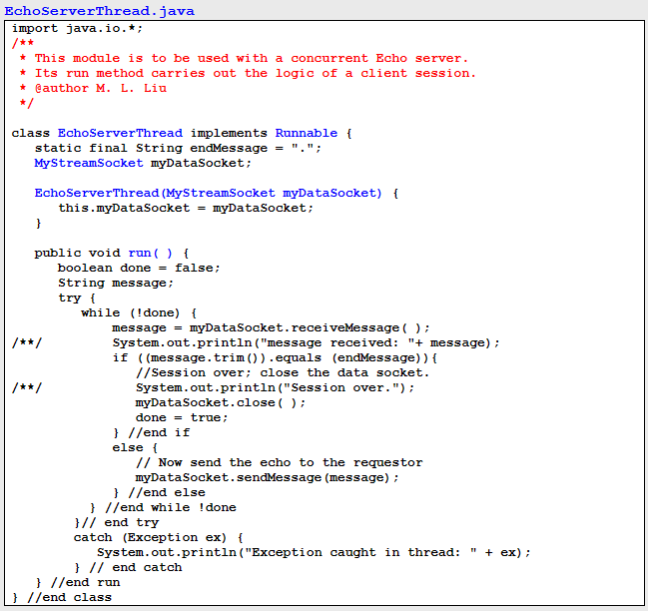

Slide 28
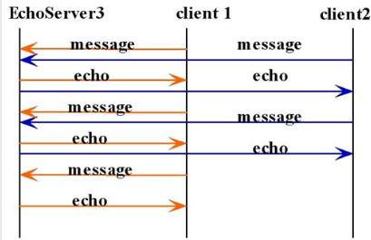
Echo3Server concurrent sessions

Slide 29
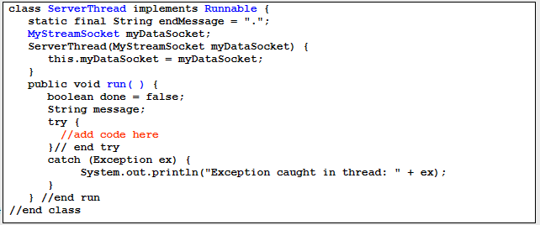
Server Thread class template

